Slide 1
Lab 4
Arrays of Objects,
Pointers and this
Object Oriented Programming Sessional
Department of Computer Science & Engineering
Bangladesh Army University of Science & Technology, Khulna

Slide 2
LAST LAB
Where we left off
Today: fifty objects at once, objects created at run time, and the pointer hidden inside every member function.
You wrote classes with constructors, destructors and a deep copy constructor.
You made a program crash by copying an object that held a pointer, then fixed it.
Everything so far has dealt with one or two objects at a time.
OOP Sessional · Lab 4 · BAUST Khulna
2

Slide 3
TODAY · 3 HOURS
The plan
A
35 min
Arrays of objects
one declaration, many complete objects
B
35 min
Object pointers
dot, arrow, new and delete
C
20 min
The this pointer
how one function serves every object
D
60 min
Exercise
a student result system, built twice
OOP Sessional · Lab 4 · BAUST Khulna
3

Slide 4
PART A
Arrays of objects
A class is a data type, so you can make an array of it.

Slide 5
PART A
The declaration is what you expect
int marks[3]; // three integers
Employee staff[3]; // three Employee OBJECTS
The constructor runs once for EVERY element. Three objects means three constructor calls.
OOP Sessional · Lab 4 · BAUST Khulna
5

Slide 6
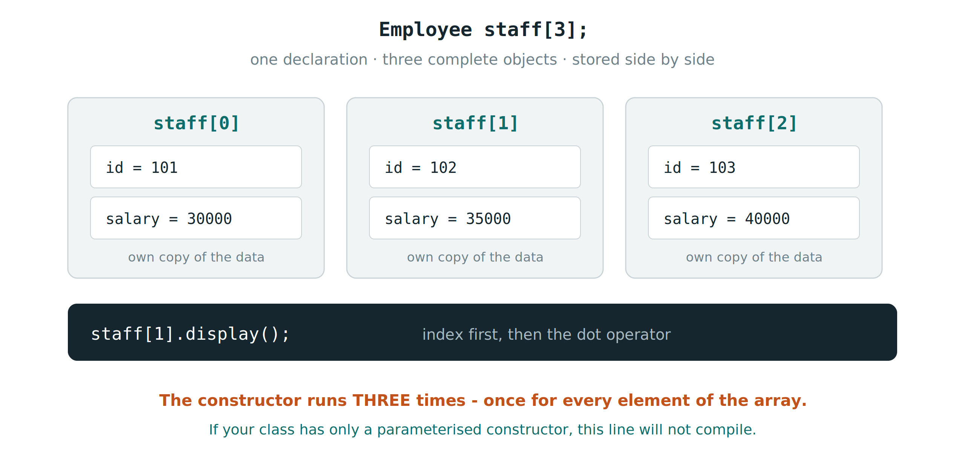
PART A
What it looks like in memory
OOP Sessional · Lab 4 · BAUST Khulna
6

Slide 7
PART A
Reaching the members
staff[0].setData(101, "Karim", 30000);
staff[1].display();
for (int i = 0; i < 3; i++)
staff[i].display();
Index first, then the dot operator.
Each element is a complete object with its own data.
The loop is the reason arrays of objects exist: one line handles fifty employees.
Try writing the loop as a range based for as well: for (Employee &e : staff)
OOP Sessional · Lab 4 · BAUST Khulna
7

Slide 8
PART A
The trap that stops the program compiling
An array declaration cannot pass arguments to each element.
So Employee staff[3]; needs a constructor that takes NO arguments.
If your class has only a parameterised constructor, the free default one is gone, and the array will not compile.
The fix is either a default constructor, or default values on every parameter.
This is Experiment 1. Delete the default constructor, compile, and record the exact error.
OOP Sessional · Lab 4 · BAUST Khulna
8

Slide 9
PART B
Object pointers
An object has an address, so a pointer can hold it.

Slide 10
PART B
Dot or arrow?
YOU HAVE
YOU WRITE
EXAMPLE
An object
object.member
c.show();
A pointer to an object
pointer->member
p->show();
A pointer, the long way
(*pointer).member
(*p).show();
An array element
array[i].member
staff[1].display();
If it has a star in front, use the arrow. That is the whole rule.
OOP Sessional · Lab 4 · BAUST Khulna
10

Slide 11
PART B
Creating objects at run time
Counter *q = new Counter; // constructor runs here
q->setValue(55);
q->show();
delete q; // destructor runs HERE
int n; cin >> n;
Counter *list = new Counter[n];
delete[] list; // note the brackets
delete[] for arrays, plain delete for a single object. Mixing them is undefined behaviour.
OOP Sessional · Lab 4 · BAUST Khulna
11

Slide 12
PART C
The this pointer
Every member function already knows which object called it.

Slide 13
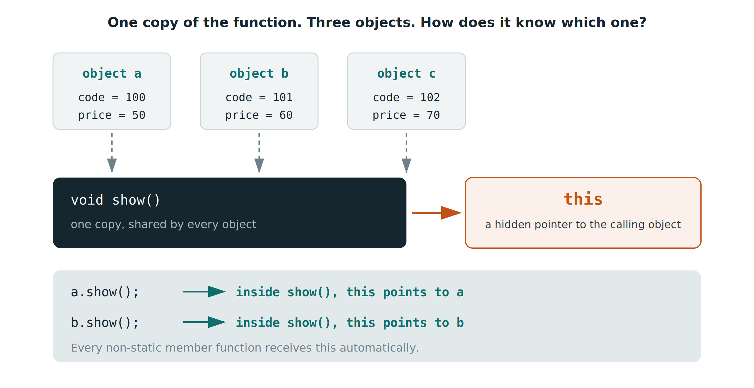
PART C
One function, many objects
OOP Sessional · Lab 4 · BAUST Khulna
13

Slide 14
PART C
Two uses you will meet today
// 1. when a parameter shadows a data member
Counter& setValue(int value)
{
this->value = value;
return *this; // 2. return the object itself
}
c.setValue(100).increment().increment().show();
Returning *this by reference is what makes those calls chain together.
OOP Sessional · Lab 4 · BAUST Khulna
14

Slide 15
PART D · 40 MINUTES
The exercise : Complex Number Class
Define a class Complex to represent a complex number consisting of a real part and an imaginary part.
The class should contain the following member functions:
  add() - Adds another complex number to the current complex number.
  subtract() - Subtracts another complex number from the current complex number.
  display() - Displays the complex number in an appropriate format.
The add() and subtract() functions should support function chaining using the dot (.) operator. For example:
    c1.add(c2).subtract(c3);
  The above statement should first add c2 to c1 and then subtract c3 from the resulting complex number.
Write a complete C++ program to implement the Complex class. The program should take appropriate input, perform the required operations using chained function calls, and display the final result.
15

Slide 16
PART D · 60 MINUTES
The exercise
Build a student result system, twice: once with a fixed array, once with new.
Write class Student with private roll, name and marks, and a DEFAULT constructor.
setData() must reject marks outside 0 to 100.
Declare Student list[5]; fill it from the keyboard, display all five.
Find the highest scorer and print the class average.
Then repeat the whole thing with Student *p = new Student[n]; and delete[].
Start from 03_lab4_task.cpp. The TODO comments are in order.
OOP Sessional · Lab 4 · BAUST Khulna
15

Slide 17
BEFORE YOU LEAVE
Lab report
All three programs with their output, the error from deleting the default constructor,
and your completed result system in both the array and the new/delete versions.
HOMEWORK · DUE NEXT LAB
Extend your result system so it also stores each student's three subject marks
in an array inside the object.
Compute each total and grade, and display a full result sheet in neat columns.
Next lab: member, inline, friend and static functions.

